Slide 1
Lights

Slide 3
J.C. Matthews Ministries

Slide 4
Table of Contents
Section I. Introduction: Faith as Law
Section II. What is Faith?
Section III. The Elements of Faith
Section IV. How Faith Works
Section V. Paradigms and Faith
Section VI. Over Coming Faith

Slide 5
I. Introduction: Faith as a Law

Slide 6
Introduction: Faith as Law
Romans 3:27-30, NKJV– “Where is boasting then? It is excluded. By what law? Of works? No, but by the law of faith. ²⁸ Therefore we conclude that a man is justified by faith apart from the deeds of the law. ²⁹ Or is He the God of the Jews only? Is He not also the God of the Gentiles? Yes, of the Gentiles also, ³⁰ since there is one God who will justify the circumcised by faith and the uncircumcised through faith. ³¹ Do we then make void the law through faith? Certainly not! On the contrary, we establish the law.”

Slide 7
INTRODUCTION - Why is it Important to Study Faith?
The question, “What is faith?” is key to Kingdom living and the fulfillment of our life’s purposes for several reasons:
Habakkuk 2:4b– “[T]he just shall live by his faith.”
2Corinthians 5:7, NIV – “For we live (walk) by faith, not by sight.”
Hebrews 11:3, KJV - Through faith we understand that the worlds were framed by the word of God, so that things which are seen were not made of things which do appear.
1John 5:4b, NIV – “This is the victory that has overcome the world, even our faith.”
Mark 9:23b, NIV – “Everything is possible for one who believes* (pisteuo).”
1Timothy 6:12, NIV – “Fight the good fight of the faith.”
Hebrews 11:6 – “And without faith it is impossible to please God”.
Romans 14:23b, ESV – “For whatever does not proceed from faith is sin.”
Therefore, having an understanding of faith from God’s perspective is of the utmost importance, for both the church and the individual, in order to fulfill our purposes in this world.
Notes:
*Pisteuo – to have faith.

Slide 8
18 Kingdom Laws for Understanding Faith
18 Kingdom Laws for Understanding Faith:
Spiritual realities and things are the precursor and primary substance of natural or seen things.
All spiritual things/realities revealed by God have as the purpose of manifestation in the earth
You most posses a thing before you can manifest the thing.
Hearing is Seeing
Hearing is Receiving
Speaking is Acting /Doing
Words are Things
Words are vehicles of communicating heaven into the earth.
God’s Word + Our Faith + Our Works = Manifestation in this world.
Notes:
Before we jump right into our study of faith, let me first reveal several laws that directly impact and influence our understanding of faith and its operation in our lives.

Slide 9
18 Kingdom Laws for Understanding Faith
18 Kingdom Laws for Understanding Faith cont.:
10. Speaking authorize the manifestation of spiritual realities in the natural world.
11. God can only manifest in the earth that which already exists in heaven.
It is illegal for God to give man supernaturally, that which he does not have faith for, i.e already possess. God requires faith.
Whatever God requires of Man He must first provide man.
Our expectations and preparation determines our manifestation.
The primary purpose for faith is manifestation (of spiritual realities in the natural world).
It is illegal for God to give man what he does not have faith for.
The Law of Dominion - “Without man God will not. Without God man cannot.”
The Law of Confession - is “to say exactly what God has said in order that God’s Will can be done.”
* The Prime Law to Subdue and Have Dominion, for which all of the others find their meaning.
Notes:
Before we jump right into our study of faith, let me first reveal several laws that directly impact and influence our understanding of faith and its operation in our lives.
*Write this law in your Notes.

Slide 10
INTRODUCTION
OLD TESTAMENT– “Faith” in Hebrew is mentioned only twice in the Old Testament (KJV).
Faith – “emunah”, from “emun” established, firmness, security, fidelity, truth.
Deuteronomy 32:20b (Negatively) – “for they are a very froward generation, children in whom is no faith.”
Habakkuk 2:4 (Positively) – “Behold, his soul which is lifted up is not upright in him: but the just shall live by his faith.”
NEW TESTAMENT– Faith is mentioned over 245 times (KJV)
Faith - “pistos” (from 3982 “peitho”) - to convince, to assent to evidence or authority, have confidence, persuasion.
Romans 1:17b – “The just shall live by faith.” (See also Galatians 3:11, Hebrews 10:38).*
QUESTION: By looking at Habakkuk 2:4 and the New Testament text of Romans, what is missing?
ANSWER: Both Old and New Testaments require faith, notice the shift in the source of faith from man’s faith to God’s.
Galatians 2:20 (KJV) – “I am crucified with Christ: nevertheless I live; yet not I, but Christ liveth in me: and the life which I now live in the flesh I live by the faith of the Son of God, who loved me, and gave himself for me.”
The reason for this shift from man’s faith (O.T.), to God’s faith (N.T.), is due to:
The indwelling of the Holy Spirit
Our responsibility to do the work of God in the earth (Ephesians 4:11-12), and
The charge to Imitate God (through Christ) in the earth (Ephesians 5:1; 1Cor. 11:1).
Notes:
“IN CHRIST,” - “THROUGH CHRIST”

Slide 11
INTRODUCTION: Kinds of Faith
All faith is not the same! There are varying kinds and qualities of faith found in scripture that properly belong and operate within a given paradigm (Salvation & Kingdom).
God provides the initial measure for faith to every man, by which man must respond to and mature to manifest God’s will and purposes in our lives, as well as, in the earth.
Remember Kingdom Law: “What God requires of man, He must first give man”.
This law also applies to faith (Hebrews 11:6 → Romans 12:3).
The measure of Faith
(Romans 12:3)
Increase Faith
(Luke 17:5)
Little Faith
Matthew 8:26
Great Faith
(Matthew 8:10)
Notes:
We now use God’’s faith to do what He requires!

Slide 12
Questions & Answers

Slide 13
II. What is Faith?
What Faith is Not

Slide 14
What is Faith?
Scripture presents Faith as a legal principle, comprised of: Substance, Evidence and Things.
Hebrews 11:1, 3 (KJV) – “Now faith is the substance of things hoped for, the evidence of things not seen. … ³ Through faith we understand that the worlds were framed by the word of God, so that things which are seen were not made of things which do appear.
(AMPC) – Now faith is the assurance (the confirmation, the title deed) of the things [we] hope for, being the proof of things [we] do not see and the conviction of their reality [faith perceiving as real fact what is not revealed to the senses]. …”
The Amplified translation conceptualizes faith as functioning as a “Title Deed”.
Titles and Deeds are commonly used in real estate transactions.
Title –is the legal representation of one’s authority or rights of ownership.
Deed - is the legal document evidencing the transfer of ownership rights in property. Legally, it is the property!
Example: The Purchase of Land.
The title is not the land itself, but is a representation of one’s legal rights in the property.
The deed is the legal evidence that proves the property has been legally transferred to another.
One can legally transact business with the deed without ever having seen or set foot on the property!
Notes:
This legal analogy is necessary to understand the Bible itself. For it concerns the transfer of the legal right to property and all that is within it!

Slide 15
Trivia
Question:
Why did the compiler and translators of the Bible decide to divide it into sections characterized as being “Covenant” and “Testaments”?
Answer:
A “covenant” is the legal means by which you transfer interest in land.
A “testament” is the legal means that one disposes of their personal property or goods.
I.e. - “Will and Testament”
Therefore, the Bible is indicating that one of its primary purposes is the revelation of God’s transfer to man:
(1) interest in land, and
(2) His goods (see Psalm 24:1 & Psalms 115:16).
Question:
What role does faith play in our ability to receive these inheritances as sons?
Answer:
Faith enables us to legally take title deed or legal possession of them, as we go about the process of literally occupying the earth (Genesis 1:28).
Notes:
Therefore, in order to properly conceptualize the bible we must do so using legal principles, and not religious ones, for it is a book established and founded in law!
This transfer usually takes place at the death of the testator. Since God cannot die, it is communicated in His absence as it relates to His direct presence, as a result of the dominion mandate.

Slide 16
What is Not Faith
Although, “belief” and “faith”, are often used interchangeably for one another in the New Testament, they are not synonymous with one another.
Faith – According to scripture (Hebrews 11:1) is the substance and evidence of unseen or yet realized realities that have not yet manifested.
Faith is the legal and personal possession of revealed realities awaiting manifestation.
Faith is not the denial of facts, but the revelation of truth in the face of facts.
The purpose of faith is the manifestation of that which is revealed.
Belief - Is the intellectual acknowledgment or agreement that a matter is true.
Belief is the ground (heart) upon which faith is grown and matured into a personal and present possession.
Mere belief does not equate to personal possession of what is believed, just agreement!

Slide 17
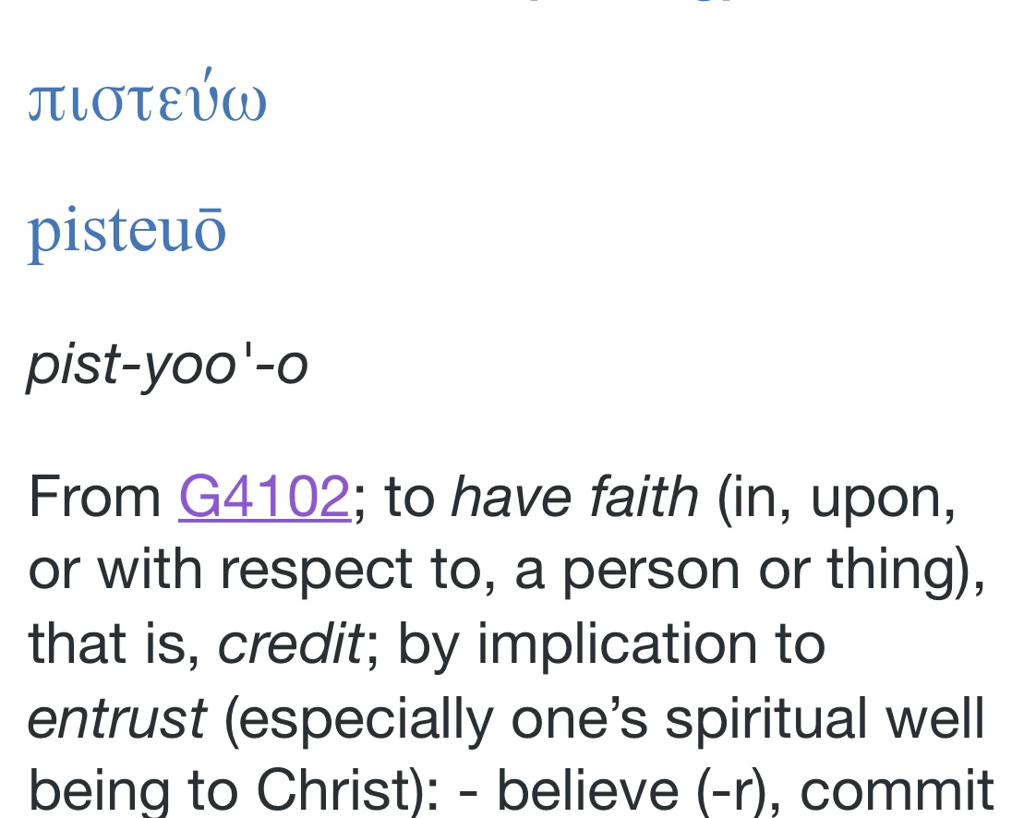
Quiz: Belief v. Faith
Read the below text. From the context define the underlined word to reveal their true meaning.
James 2:19, NKJV – “You believe that there is one God. You do well. Even the demons believe—and tremble!”
“Demons are never said to have faith!
Mark 9:21-24, NKJV – “So He asked his father, “How long has this been happening to him?” And he said, “From childhood. ²²And often he has thrown him both into the fire and into the water to destroy him. But if You can do anything, have compassion on us and help us.” ²³Jesus said to him, “If you can believe, all things are possible to him who believes.” ²⁴Immediately the father of the child cried out and said with tears, “Lord, I believe; help my unbelief!”
Matthew 9:28, KJV – “And when he was come into the house, the blind men came to him: and Jesus saith unto them, Believe (G4100) ye that I am able to do this? They said unto him, Yea, Lord.²⁹ Then touched he their eyes, saying, According to your faith be it unto you.”
Belief was the acknowledgement that Jesus was able to do it.
Faith was the means by which the man received what he believed Jesus could do.
Red = Acknowledge or Agree. Purple = Faith (receive it).
Notes:
James - Believe – “acknowledge” that a thing is true. Red is intellectual belief, Purpose is equivalent to Faith.
Mark – believe should be translated “faith” in vs. 23
Unbelief = lack of faith. ” vs. 24 – “I believe (acknowledge), but help my lack of faith”

Slide 18
Belief is Not Faith
The main difference between belief and faith is found in the quality, degree and purpose of the truth received.
Belief is the intellectual acknowledgement that a thing is true,
Faith is the entrusting and crediting of a matter as being a present reality that has been legally received as a personal possession.
From a Kingdom perspective, the quality and degree of belief, in order to transition to faith, requires the personal reception of what is believed as being true as a present reality upon which one acts and lives upon.

Slide 19
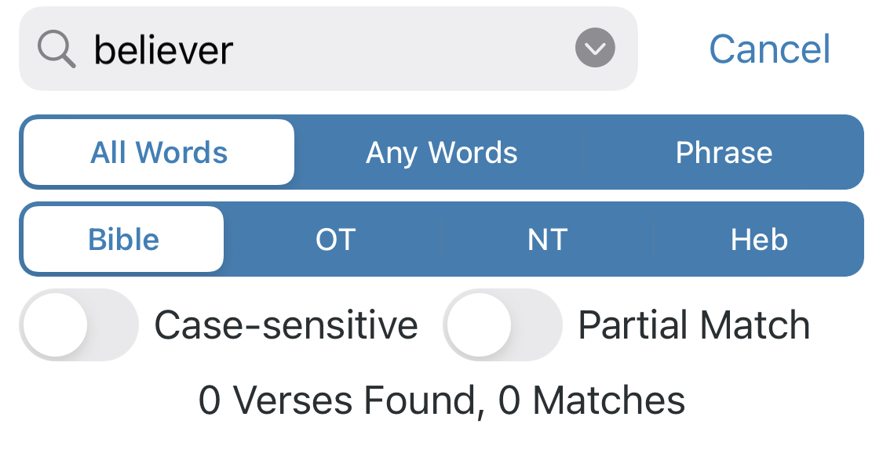
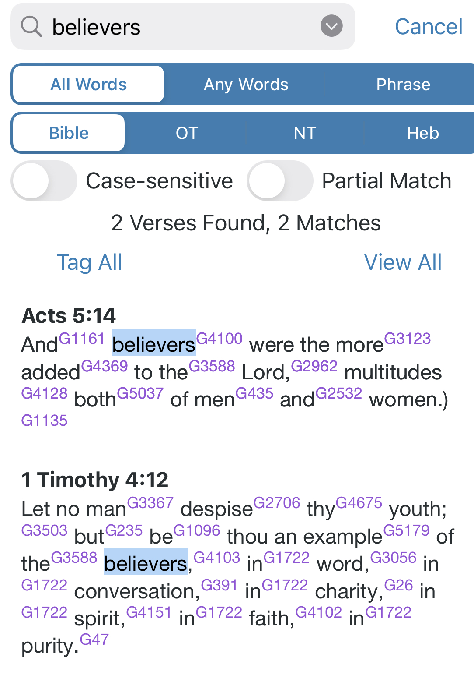
The Problem with Being “Mere Believers”
The Problem with being Characterized as a “Believer”?
Belief / Believer is an introductory level or position within the Kingdom and its economy and cannot be used to define Kingdom Citizens.
In the King James translation, the word “believer” is not mentioned, and while “believers” is only mentioned twice and used to identify those who are new converts or immature in the faith.
This perpetuates a self perception of perpetual immaturity.
We are charged with progressing from believing, to manifesting what has been received as disciples and imitating Christ. Believer to Disciple.
Luke 6:40, NKJV – “A disciple is not above his teacher, but everyone who is perfectly trained will be like his teacher.

Slide 20
In Summary
Belief is:
The acknowledgement or agreement that a thing is true.
Intellectual at its foundation and does not require the personal reception and application of the truth in one’s life for manifestation.
The starting point upon which faith is developed and matured.
Faith is:
A legal concept that involve the legal possession and ownership of that which is true but yet unseen or manifested.
More than the mere belief in a thing’s truth, but the personal reception of it.
Both substance and evidence that we receive, which serves to ensure us of a reality that is unseen or unmanifested.
Required for manifestation.

Slide 21
Questions & Answers

Slide 22
III. The Elements of Faith
Hebrews 11:1

Slide 23
The Elements of Faith
As stated earlier, Faith is not merely belief, but is comprised of both spiritual unseen substance and legal evidence.
This composition of both the spiritual and legal establishes a law that man must be understand in order for us to fulfill our purpose within God’s Kingdom on earth.
With Faith’s objective being manifestation, we must understand how we are to engage this spiritual law in relationship to our engaging the natural world.
Without an understanding of both the spiritual, legal and natural, there can be no manifestation.
By studying the elements of faith, we are able to more readily identify its core components, operation and purpose within God’s Kingdom.

Slide 24
Elements of Faith
Romans 10:17, KJV – “So then faith cometh by hearing, and hearing by the word of God.”
PART A - “So then faith cometh by hearing”
PART B – “hearing (comes) by the word of God.”
Therefore, God’s Word enables us to hear, which in turn produces faith.
This implies that we cannot truly “hear”, without first having “heard” God’s Word!
This kind of hearing is not a fruit of our natural ears, because it is a spiritual work that requires the assistance and empowerment of the Holy Spirit of God.
Remember the Law: Whatever God requires of man He must first provide him.
God’s Word is spirit, which quickens or ability to hear or discern spiritual things.
John 6:63b, KJV – “the words that I speak unto you, they are spirit, and they are life.”
Hebrews 4:12, NKJV – “For the word of God is living and powerful, and sharper than any two-edged sword, piercing even to the division of soul and spirit, and of joints and marrow, and is a discerner of the thoughts and intents of the heart.”

Slide 25
How Faith Works -- How is Faith Developed?
Since this kind of hearing is not natural, but spiritual, it is necessary to understand the spiritual laws that govern our operation as spiritual sons of God in His Kingdom.
In the Kingdom (Laws):
Hearing is Seeing
Believing / Faith is Receiving
Acting/Working is Speaking
These 3 abilities enable and equip us to communicate what is unseen into the natural world for manifestation.

Slide 26
Elements of Faith
Example:
John 5:19-20, NKJV – “Then Jesus answered and said to them, “Most assuredly, I say to you, the Son can do nothing of Himself, but what He sees* the Father do; for whatever He does, the Son also does in like manner. ²⁰ For the Father loves the Son, and shows Him all things that He Himself does; and He will show Him greater works than these, that you may marvel.
*God is an unseen Spirit! Therefore, we cannot be speaking of natural sight, but another dimension of discernment that is its equivalent in the spirit!
Translated: - “Then Jesus answered and said to them, “Most assuredly, I say to you, the Son can say nothing of Himself, but what He hears the Father say; for whatever He says, the Son also says in like manner. ²⁰ For the Father loves the Son, and tells Him all words that He Himself says; and He will tell Him greater words than these, that you may marvel.
Genesis 1&2
Genesis 1 (3, 6, 7, 9, 11, 14, 15, 20, 24, 26) - God said … and it was so”
Genesis 2:2-3, NKJV - “And on the seventh day God ended His work which He had done, and He rested on the seventh day from all His work which He had done. ³ Then God blessed the seventh day and sanctified it, because in it He rested from all His work which God had created and made.
Hebrews 11:3, KJV – “Through faith we understand that the worlds were framed by the word of God, so that things which are seen were not made of things which do appear.
In Summary: God created the spiritual substance of all things through speaking (His Word), and then approached the earth for the preexisting corresponding natural material to manifest what He created to fulfill its creative purpose
See Genesis 1:27 and Genesis 2:7.

Slide 27
Elements of Faith
The development and maturation of our Hearing is essential because, as in the natural it impacts all of the other spiritual abilities.
See Mark 7:31-35, NIV
"Then Jesus left the vicinity of Tyre and went through Sidon, down to the Sea of Galilee and into the region of the Decapolis. ³² There some people brought to him a man who was deaf and could hardly talk, and they begged Jesus to place his hand on him.³³ After he took him aside, away from the crowd, Jesus put his fingers into the man’s ears. Then he spit and touched the man’s tongue. ³⁴ He looked up to heaven and with a deep sigh said to him, “Ephphatha!” (which means “Be opened!”). ³⁵ At this, the man’s ears were opened, his tongue was loosened and he began to speak plainly.
Therefore, the ability to hear is directly related to our ability to speak, as well as, impacting all the other primary abilities necessary for us to operate or live by faith.
Without this kind of hearing, we are deaf, blind, mute and dumb!

Slide 28
Questions & Answers

Slide 29
The Word of God: Hearing, Revelation & Understanding
Spiritual Hearing, being a fruit of God’s Word, allows us to receive spiritual things that have yet to manifest, but are realities.
Therefore, hearing involves spiritual discernment in order to receive spiritual realities.
The Word of God provides the revelation necessary to discern and receive these spiritual things.
The Bible says that the Word of God is Light.
Psalms 119:105, NKJV – “Your word is a lamp to my feet and a light to my path.”
Psalms 119:30, NKJV – “The entrance of Your words gives light; It gives understanding to the simple.”
The bible also says that God’s Word is the creative substance and power that holds together of all things, while giving us the ability to understand or discern them.
Hebrews 11:3, KJV – “Through faith we understand that the worlds were framed by the word of God, so that things which are seen were not made of things which do appear.
Hebrews 1:3, KJV – “Upholding all things by the word of his power …”
See also John 1:1-3

Slide 30
The Word of God: Hearing and Revelation
Therefore, God’s word not only gives us the power to discern, through revelation, but provides us understanding of spiritual things.
1Corinthians 2:9-12, KJV – “But as it is written, Eye hath not seen, nor ear heard, neither have entered into the heart of man, the things which God hath prepared for them that love him.¹⁰ But God hath revealed them unto us by his Spirit: for the Spirit searcheth all things, yea, the deep things of God.¹¹ For what man knoweth the things of a man, save the spirit of man which is in him? even so the things of God knoweth no man, but the Spirit of God.¹² Now we have received, not the spirit of the world, but the spirit which is of God; that we might know the things that are freely given to us of God.
Revelation v. Creation Defined
Although both Revelation and Creation are a fruit of the Word of God, they are not the same.
Revelation reveals what already in exists, while Creation is the act of bringing a thing into existence.
What is received by revelation through our hearing already was in existence, but was not discernable by the natural sense.
Therefore, Faith is the legal process by which through our spiritual senses we discern, understand and receive spiritual things from God and His Word for the purpose of manifestation in this world.

Slide 31
The Elements of Faith
Faith is Revelation & Understanding
Hebrews 11:3, NKJV – “By faith we understand that the worlds were framed by the word of God, so that the things which are seen were not made of things which are visible.”
Because Faith is comprised of spiritual substance (the Word of God), it require a transformed (spiritual not carnal) mind to understanding and discern what is revealed as being real.
A ”Carnal Mind” is defined as: A mind that is unable to walk by faith, and not but the natural senses.
Spiritual things are foolishness to the “carnal mind” (1Corinthians 2:14).
Hebrews 11:1 tells us that Faith is comprised of:
Substance – a present reality that is a fruit of God’s Word
Things – It is a present created reality that has been assigned a purpose in this world.
Hope – We are conscious of its existence due to the word, but is yet seen. (See Romans 8:24b).
Evidence – The legal verification of its existence despite our factual or natural senses.
Things Not Seen – Spiritual substance awaiting manifestation.
Notes:
2Cor.4:18 – we must use the eyes of faith to properly esteem the reality in which we live.
Hope: - Romans 8:24b - “[H]ope that is seen is no hope at all. Who hopes for what he can already see?

Slide 32
The Elements of Faith
Refresher: The Word of God is the Source of Faith and Substance/Things
John 1:1-3, NKJV – “In the beginning was the Word, and the Word was with God, and the Word was God. ² He was in the beginning with God. ³ All things were made through Him, and without Him nothing was made that was made.
Hebrews 11:3, NKJV – “By faith we understand that the worlds (universe, NIV) were framed by the word of God, so that the things which are seen were not made of things which are visible.
2 Corinthians 4:18, NKJV – “while we do not look at the things which are seen, but at the things which are not seen. For the things which are seen are temporary, but the things which are not seen are eternal.”
The Word of God –Biblical Faith can only be produced by the word of God, because it is reveals what is already so and is not subject to a change in circumstances, i.e. it is settled as being so.
Faith, being the substance of things not seen, without the word of God is foolishness, because there is no evidence of its present reality. The Word is the thing and evidence of its existence.
Notes:
2Cor.4:18 – we must use the eyes of faith to properly esteem the reality in which we live.
Hope: - Romans 8:24b - “[H]ope that is seen is no hope at all. Who hopes for what he can already see?

Slide 33
How Does Faith Come?
The Operation of the Elements of Faith
FAITH
WORD OF GOD
Romans 10:17
SUBSTANCE
Hebrews 11:1
EVIDENCE
Hebrews 11:1
UNDERSTANDING
Hebrews 11:3
REVELATION by the Word & Spirit of God
Hebrews 11:3
Faith is a fruit of the Word of God.
Romans 10:17 – “Faith comes by hearing, hearing by the word of God.”
The Word of God is the substance of all things, seen and unseen.
The Word of God produces Understanding.
Understanding is a fruit of Revelation.
Hebrews 11:3 – “By faith we understand …”
Revelation is a fruit of the Word and Spirit.
Therefore, our faith and understanding is found in the hearing of God’s Word and receiving as done what was heard..
Faith is therefore access, and the ability, to receive, that which could not otherwise be discerned but by the revelation of God’s Word and Spirit!

Slide 34
Questions & Answers

Slide 35
IV. How Faith Works

Slide 36
How Faith Works
To understand the operation of Faith, we must set aside our religious (Salvation Paradigm) perspective of faith, and view it as a Law, or set of principles, that work together to manifest God’s will and purpose in the earth.
Faith requires that:
We first perceive and receive from the unseen substance from the spiritual realm,
We engage the natural world to manifest what was spiritually received, i.e. works.
This requires that we move beyond mere intellectual belief or agreement to our acting upon the substance received by faith to manifest it.
Therefore, faith equips us to engage spiritual realities and qualifies us to partner with God in His work of manifesting His will and heaven in the earth.

Slide 37
How Faith Works
The Work of God
Ephesians 4:11-12, NLT – “Now these are the gifts Christ gave to the church: the apostles, the prophets, the evangelists, and the pastors and teachers. ¹² Their responsibility is to equip God’s people to do his (God’s) work and build up the church, the body of Christ. …”.
Matthew 16:19, NKJV – “And I will give you the keys of the kingdom of heaven, and whatever you bind on earth will be bound in heaven, and whatever you loose on earth will be loosed in heaven.”
See the Amplified Classics Translation of this text.

Slide 38
How Faith Works
Consider the Amplified Classic Translation
Matthew 16:19, AMPC –” I will give you the keys of the kingdom of heaven; and whatever you bind (declare to be improper and unlawful) on earth ^{[a]}must be what is already bound in heaven; and whatever you loose (declare lawful) on earth ^{[b]}must be what is already loosed in heaven.”
[a & b] Charles B. Williams, The New Testament: A Translation: [in the Greek] “The perfect passive participle, here referring to a state of having been already forbidden [or permitted].”
This insinuates that we are “law enforcement” here on earth whereby we are to, by faith, receive that which has already been established as either lawful or unlawful in heaven and make it so here on earth.
God provides the substance upon which we are to act in the natural world to establish in the earth.
We will see Matthew 16:19 again in our study of Faith as a Law.

Slide 39
How Faith Works?
Faith as Authorization
God requires an act of faith, or authorization, no matter how small, to legalize His intervention into our affairs.
This is a result of The Law of Dominion which designated man as the sovereign ruler (dominion) over the affairs of the earth, whereby any manifestation on it must have man’s authorization or participation, which is manifested by some act on his part.
Genesis 1:26, NKJV – “Then God said, “Let Us make man in Our image, according to Our likeness; let them have dominion over the fish of the sea, over the birds of the air, and over the cattle, over all the earth and over every creeping thing that creeps on the earth.”
Law: “Without man God will not, and without God man cannot”.

Slide 40
How Faith Works?
Our Work:
James 2:14-26 reminds us that faith, without works is dead, or of no effect.
In the New Testament, whenever Jesus performed a miracle, He required the recipient to perform some act of faith that legalized their reception of what they were asking for.
Romans 14:23b, KJV – “for whatsoever is not of faith is sin”.
Law: “It is illegal for God to give man that which He does not have faith for”.
Examples
Stand up – John 5:1-9
Stretch out your hand – Mark 3:5
Lepers told to Go wash themselves – John 9:7
Give the oil and water (Widow) 1Kings 17:7-16
Speak to or say to …. – Matthew 21:21 and Mark 11:23

Slide 41
How Faith Works
Partners with God – Power & Authority
God’s Faith and our works in the natural form a partnership through which God is legally able to manifest His will in the earth as it is in heaven.
2Corinthians 6:1, NLT – “As God’s partners, we beg you not to accept this marvelous gift of God’s kindness and then ignore it.”
1Corinthians 3:9, NIV, - “For we are co-workers in God’s service …”.
This partnership is not an equal one, but a necessary one due to the Law of Dominion.
God is required to provide the Power or ability, while man is required to yield his Authority given him over the earth to God, thereby granting Him access and authorization to act on man’s behalf.
Like Belief and Faith, which are often used interchangeably, but are different, so is Power and Authority!
Definition:
Power is the ability to do a thing. See 1Peter 5:11 – “For all power belongs to God, now and forever. Amen.”
Authority is the legal right to do a thing. – See Psalms 115:16, NKJV – “The heaven, even the heavens, are the Lord’s; But the earth He has given to the children of men.” (Contrast to Psalms 24:1).
God’s Power + Man’s authority authorizes = Manifestation in the Earth

Slide 42
How Faith Works
Partners with God –Action & Authority
Exodus 14:15-16, NKJV – “And the Lord said to Moses, “Why do you cry to Me? Tell the children of Israel to go forward. ¹⁶ But lift up your rod, and stretch out your hand over the sea and divide it. And the children of Israel shall go on dry ground through the midst of the sea.”
Moses, in performing the miracles, was required to provide an act of faith, such as casting his rod down, speaking and lifting his hands, in order to authorize God’s intervention into their situation.
Exodus 3:7-10, NKJV - And the Lord said: “I have surely seen the oppression of My people who are in Egypt, and [I] have heard their cry because of their taskmasters, for I know their sorrows. ⁸ So I have come down to deliver them out of the hand of the Egyptians, … ⁹ Now therefore, behold, the cry of the children of Israel has come to Me, and I have also seen the oppression with which the Egyptians oppress them. ¹⁰ Come now, therefore, and I will send you to Pharaoh that you may bring My people, the children of Israel, out of Egypt.”
Note: Moses’ primary work in partnering with God in delivering Egypt was speaking* (saying what God said).
Although God had to await the authorization and participation of Moses (Man) in order for Him to take action so that His will was done in the earth, He considered Moses’ actions as His! (See Ephesians 4:11-12, NLT).

Slide 43
Questions & Answers

Slide 44
How Faith Works
Speaking is Working!
A paradigm shift that must take place in our thinking concern our perceiving Speaking is Working!
Reading, meditating, or memorizing the word is for the development and establishment of the thing within you.
Faith, and this world, are word operated!
Because God’s Word created all things, all things are responsive to His Word.
Therefore, one of the required works that we must become equipped to perform is acting like God, through our speech.
God’s word possess the things that are in His mind, which He intends to manifest (1Corinthians 2:9-12).
These are “Faith filled words” or speech that are legally decrees, which the Bible says “establishes the thing” (Job 22:28).
This is what we see in Genesis 1 and 2, ie. “God said …. and it was so.”
Notes:
In performing the miracles we saw Moses perform acts of faith such as casting his rod down, lifting his hands, ect… These were the necessary

Slide 45
How Faith Works - SPEAKING IS WORKING
GENESIS 1
^{3 ”}And God said, Let there be light: and there was light. … ⁷ And God made the firmament, and divided the waters which were under the firmament from the waters which were above the firmament: and it was so.
⁹ And God said, Let the waters under the heaven be gathered together unto one place, and let the dry land appear: and it was so.
¹¹ And God said, Let the earth bring forth grass, the herb yielding seed, and the fruit tree yielding fruit after his kind, whose seed is in itself, upon the earth: and it was so.
¹⁴ And God said, Let there be lights in the firmament of the heaven to divide the day from the night; and let them be for signs, and for seasons, and for days, and years: ¹⁵ And let them be for lights in the firmament of the heaven to give light upon the earth: and it was so.
²⁰ And God said, Let the waters bring forth abundantly the moving creature that hath life, and fowl that may fly above the earth in the open firmament of heaven. ²¹ And God created great whales, and every living creature that moveth, which the waters brought forth abundantly, after their kind, and every winged fowl after his kind: and God saw that it was good (it was so).
²⁴ And God said, Let the earth bring forth the living creature after his kind, cattle, and creeping thing, and beast of the earth after his kind: and it was so.
²⁶ And God said, Let us make man in our image, after our likeness: and let them have dominion over the fish of the sea, and over the fowl of the air, and over the cattle, and over all the earth, and over every creeping thing that creepeth upon the earth. ²⁷ So God created man in his own image, in the image of God created he him; male and female created he them.
²⁹ And God said, Behold, I have given you every herb bearing seed, which is upon the face of all the earth, and every tree, in the which is the fruit of a tree yielding seed; to you it shall be for meat. ³⁰ And to every beast of the earth, and to every fowl of the air, and to every thing that creepeth upon the earth, wherein there is life, I have given every green herb for meat: and it was so.”
GENESIS 2
”And on the seventh day God ended his work which he had made; and he rested on the seventh day from all his work which he had made.”

Slide 46
How Faith Works - SPEAKING IS WORKING
Since speaking is the primary law by which we work in the Kingdom, we must also understand a principle in this law that causes our act of faith (speaking) to be effective and certain.
In order for us to effectively partner with God in His work in this world is the the Law of Confession (See Conclave V 2021)
Due to religious reasons the concept of “confession” has lost its true meaning and application within the lives of those who are citizens of God’s Kingdom.
Today our understanding of confession has devolved to being the act of telling another our sins, such as a priest, or admitting wrong-doing to someone in authority, such as in a law enforcement or a court.
However, in the Kingdom, confession is “homologio”, which means: “to say what has been said” or to “say the same thing”.
Simply stated, The Law of Confession: is “to say exactly what God has said in order that God’s Will can be done.”

Slide 47
How Faith Works: God’s Voice & Our Words
Faith-filled confession is the “work” given man in order for God’s will to have free course in the earth, as a result of the “Law of Dominion”, i.e. God must use a man in the earth.
Effective confession involves, not only us saying what God has said, but in a manner, and from a position whereby His Voice is heard in our words. (See “The Law of Delegation” – Conclave V 2021).
Voice and Words Distinguished:
THE VOICE– Communicates the Presence of the Persons. Voice = Presence
Genesis 3:8, KJV – “And they heard the voice of the LORD God walking in the garden in the cool of the day: and Adam and his wife hid themselves from the presence of the LORD God amongst the trees of the garden.”
THE WORDS– are the vehicle by which God sends the substance of what is not seen yet (hoped for) from one place to another, i.e. heaven to earth.
Psalm 107:20, NKJV – “He sent His word and healed them …”
When we speak, in order for our words to have any force or authority in the earth, they must contain the Voice (presence) of God in them for His creation to respond to them.

Slide 48
How Faith Works: God’s Voice & Our Words
Ezekiel 37:1-10, NKJV – “The hand of the Lord came upon me and brought me out in the Spirit of the Lord, and set me down in the midst of the valley; and it was full of bones. ² Then He caused me to pass by them all around, and behold, there were very many in the open valley; and indeed they were very dry. ³ And He said to me, “Son of man, can these bones live?” So I answered, “O Lord God, You know.”
⁴ Again He said to me, “Prophesy (speak) to these bones, and say to them (confess), ‘O dry bones, hear the word of the Lord! ⁵ Thus says the Lord God to these bones: “Surely I will cause breath to enter into you, and you shall live. ⁶ I will put sinews on you and bring flesh upon you, cover you with skin and put breath in you; and you shall live. Then you shall know that I am the Lord.”
⁷ So I prophesied (spoke), as I was commanded (confession) ; and as I prophesied (spoke), there was a noise, and suddenly a rattling; and the bones came together, bone to bone. ⁸ Indeed, as I looked, the sinews and the flesh came upon them, and the skin covered them over; but there was no breath in them.
⁹ Also He said to me, “Prophesy (speak) to the breath, prophesy (speak), son of man, and say to the breath, ‘Thus says the Lord God: “Come from the four winds, O breath, and breathe on these slain, that they may live.”
¹⁰ So I prophesied as He commanded me, and ^{[b]}breath came into them, and they lived, and stood upon their feet, an exceedingly great army.

Slide 49
How Faith Works: God’s Voice & Our Words
All of God’s creation is designed to respond to the voice of God, being a fruit of it and His Word.
Angels harkening to our words & God’s Voice
Psalms 103:19-20, NKJV – “The Lord has established His throne in heaven, and His kingdom rules over all.²⁰ Bless the Lord, you His angels, who excel in strength, who do His word, heeding the voice of His word.”
Creation Harkens to Gods’ Voice in Our Words
Romans 8:19, NKJV –” For the earnest expectation of the creature waiteth for the manifestation of the sons of God.”
Jesus revealed this principle/law when he said:
John 12:49, NKJV – “For I have not spoken on My own authority; but the Father who sent Me gave Me a command, what I should say and what I should speak.”
This is why when ever Jesus commanded the disciples to speak to creation, He made it a prerequisite that it be done in faith; for “faith comes by hearing and hearing by the Word of God” (Romans 10:17).
See Mark 11:22-23 – “Have faith in (of) God … “.
Angels and creation are not so much obeying us, but the voice of the One who gave us the words* and authorized to speak on His behalf. They are responds to the voice of God in our words!
For our words of Faith to have any force they must possess the not only the substance (Word), but the Voice of God in them!
See Acts 19:11-15 (The 7 Sons of Sceva)
Notes:
*The Law of confession & The Law of Delegation

Slide 50
Questions & Answers

Slide 51
Conceptualizing Faith as “Communication”
God’s Thoughts
Thoughts are the initial substance of all things/realities awaiting expression or manifestation in the natural realm.
God’s Words
Words are carriers that give expression to thoughts for communication/reception to their destination through hearing.
Our Hearing
Hearing is the ability to receive the thing of God into this world.
Our Works - Words
See Genesis 1 & 2.
Corresponding actions (Works/Words)done in the natural realm to facilitate their manifestation in the earth.

Slide 52
Faith as “Communication”
Remember what Hebrews 11:1 says: “Now faith is the substance of things hoped for, the evidence of things not seen.”
Faith is comprised of unseen, but revealed, realities that are awaiting manifestation.
These realities are in an intangible and spiritual state of being that requires a vehicle or means to enter the natural world.
This means or vehicle are “words”. Words are carriers of spiritual substance.
Consider Matthew 12:36, NIV – “But I tell you that everyone will have to give account on the day of judgment for every empty word they have spoken.
The Vehicle of Verbalization
The root of the word “verbalize” (i.e. speak) is the word “verb”, which means: action, doing or movement.
Therefore, when we are speaking, we are moving substance from one place to another.
Words are “Verbal Vehicles” (i.e. verbalization) that communicate things from one dimension to another.
Therefore, from a Kingdom perspective and law – speaking is both how we: (1) act, do, and (2) move things.
Both the initial creation (God) and realization in the natural world (Us) are accomplished through the act of speaking faith-filled words.

Slide 53
Conceptualizing FAITH as “Communication”
From a Kingdom conscious perspective, “communication” is not simply the act of having a conversation with someone, but our transferring substance from one place or person to another.
A
B
Notes:
translated us into the kingdom - How? By Faith!

Slide 54
How Faith Works
God uses His Word as a vehicle to communicate heaven and its resources into the earth.
GOD’S WORD Creative Substance
CREATION
Hearing + Believing
God’s Word
Receipt by Faith
God’s Word
MANIFESTATION
of God’s Word Word or Deed
REVELATION
POSSESSION
MANIFESTATION

Slide 55
Questions & Answers

Slide 56
How Faith Works – Giving God Something to Work With
The degree in which we can realize manifestation in our life is determined by the quality of faith we can produce, which is a direct reflection of the quality of word we hear.
Speaking, being the primary means by which we work in the Kingdom, is a consequence of the Word we hear. For “faith Comes by hearing, hearing by the word of God” (Romans 10:17).
See Hebrews 5:12-13, AMPC – “For even though by this time you ought to be teaching others, you actually need someone to teach you over again the very first principles of God’s Word (Salvation Paradigm). You have come to need milk, not solid food.¹³ For everyone who continues to feed on milk is obviously inexperienced and unskilled in the doctrine of righteousness (of conformity to the divine will in purpose, thought, and action), for he is a mere infant [not able to talk yet]!

Slide 57
How Faith Works – Giving God Something to Work With
Remember: Hearing is seeing, speaking is doing. If what we our speaking is impaired due to what we are hearing, then we are hindered in our ability to do (and say) what is necessary in order to manifest the things that God has freely given us, but are only spiritually discerned (seen by hearing) and acquired by our speaking (doing). See 1Corinthians 2:9-14.
Let us review the entire text. 1Corinthians 2:9-14:
“But as it is written: “Eye has not seen, nor ear heard, Nor have entered into the heart of man The things which God has prepared for those who love Him.” ¹⁰ But God has revealed them to us through His Spirit. For the Spirit searches all things, yes, the deep things of God. ¹¹ For what man knows the things of a man except the spirit of the man which is in him? Even so no one knows the things of God except the Spirit of God. ¹² Now we have received, not the spirit of the world, but the Spirit who is from God, that we might know the things that have been freely given to us by God. ¹³ These things we also speak, not in words which man’s wisdom teaches but which the Holy Spirit teaches, comparing spiritual things with spiritual. ¹⁴ But the natural (carnal) man does not receive the things of the Spirit of God, for they are foolishness to him; nor can he know them, because they are spiritually discerned.”

Slide 58
How Faith Works?
As we close out this section on “How Faith Works” there is a final revelation concerning the operation of faith that must be understood. It involves the position of the one engaging faith.
If we are the one who is to operating/exercising by faith, God provides His faith upon which we are to work.
If we are the one seeking to receive(ing) from God, something by faith, manifestation is determined by the level of our faith.
We witness in the New Testament Jesus basing a miracle upon the persons faith, not His!
Matthew 9:27-29, NIV – “As Jesus went on from there, two blind men followed him, calling out, “Have mercy on us, Son of David!” ²⁸ When he had gone indoors, the blind men came to him, and he asked them, “Do you believe that I am able to do this?” “Yes, Lord,” they replied.²⁹ Then he touched their eyes and said, “According to your faith let it be done to you”.
Luke 7:50, NIV – “Jesus said to the woman, “Your faith has saved you; go in peace.”
Luke 8:48, NIV – “Then he said to her, “Daughter, your faith has healed you. Go in peace.”
*Matthew 13:58, NIV – “And he (Jesus) did not do many miracles there because of their lack of faith.”
*Mark 9:22-24, NKJV – “ But if You can do anything, have compassion on us and help us.” ²³Jesus said to him, “If you can believe, all things are possible to him who believes.” ²⁴Immediately the father of the child cried out and said with tears, “Lord, I believe; help my unbelief!”
Therefore, manifestation of God’s power I our lives is available, but dependent upon our faith – not God’s!

Slide 59
Questions & Answers

Slide 60
V. Faith & Paradigms
The Problem with Our Paradigm

Slide 62
Paradigms of Faith
When speaking of faith, we must recognize it unique work and kind within the differing paradigms.
The two (2) major Paradigms found in scripture is the Salvation Paradigm and the Kingdom Paradigm.
Salvation Paradigm faith concerns how one receives from God that which is necessary for them to be right with God, i.e. righteousness and salvation.
Kingdom Paradigm faith concerns our manifesting that which we have received by grace. It is an empowerment to manifest what we have become.
Salvation
Paradigm
Kingdom
Paradigm

Slide 63
Paradigm and Our Perception
Most people are not aware that they adhere to a given paradigm because it was handed down to them by those within their community.
These paradigms often go unquestioned or unchallenged by its members.
The church has, over the last 500 years, been operating from a “Salvation Paradigm*” as a result of the Protestant Reformation, which focused on settling the issue of what is the “basis” of our salvation.
This paradigm has unknowingly caused the church’s focus to turn inward and to forsake its provision and assignment of manifesting God’s Kingdom in the: (1) lives of its citizens, and the earth!
Notes:
*What exactly is a Salvation Paradigm will be discussed in greater detail and length later on in this study.

Slide 64
Paradigms
The word “paradigm” comes from the Greek word ”parádeigma” and “paradeiknýnai” which means: “pattern”, or “to show side by side”
Paradigm Defined: “A frameworks comprised of accepted norms, traditions and assumed truths that make sense of, and gives organization to, the world to which it is applied, while providing definition and understanding of this world to its community.”
Paradigms function as the lens through which we perceive our world.

Slide 65
Paradigms of Faith
The major difference between the two paradigms (Salvation and Kingdom) is the kind and quality of faith.
Salvation Paradigm Faith concerns the Legal Acquisition of a reality, i.e. righteousness (i.e. “title deed” – See Hebrews 11:1, AMPC).
Kingdom Paradigm Faith concerns the Literal Manifestation of what has been legally received.
For the Salvation Paradigm of faith, works are excluded, while in the Kingdom Paradigm of Faith works are required.
Therefore, Kingdom Paradigm faith is frustrated by the church which has adopted a Salvation Paradigm Perspective of itself, which denounces works in the life of its members, viewing them as works for righteousness sake, instead of works for manifestation sake.
Salvation
Paradigm
Kingdom
Paradigm

Slide 66
Kingdom Paradigm
The realm of the saved by grace and sons of God.
Salvation is presumed as a fact in the individual’s life.
We legally own every spiritual blessing, gift empowerment, promise and provision given us as our inheritance and sonship to God.*
Kingdom Paradigm Focus is not attempting to acquire anyting from
God, but to manifest what has already been received:
Our sonship in the earth
God’s Kingdom in the earth.

Slide 67
Salvation Paradigm
Addresses the ABC’s of FAith
The Assurance of our Salvation
The Basis of our Salvation
The Basics of our Salvation – Assurance
Christ as the Source of our Salvation
Salvation Paradigm Messages characteristically focus upon:
Jr. Cs. = Justification, Righteousness, Circumcision & Salvation, or for “Jr. Christians”(Jr.Cs).
It is Evangelical in nature.

Slide 68
Impact of Paradigms upon Faith
Romans 3:28, NKJV – “Therefore we conclude that a man is justified by faith apart from the deeds (works) of the law.” (Salvation Paradigm).
James 2:18-24, NKJV - “But someone will say, “You have faith, and I have works.” Show me your faith without your works, and I will show you my faith by my works. ¹⁹ You believe that there is one God. You do well. Even the demons believe—and tremble! ²⁰ But do you want to know, O foolish man, that faith without works is dead? ²¹ Was not Abraham our father justified by works when he offered Isaac his son on the altar? ²² Do you see that faith was working together with his works, and by works faith was made perfect? ²³ And the Scripture was fulfilled which says, “Abraham believed God, and it was accounted to him for righteousness.” And he was called the friend of God. ²⁴ You see then that a man is justified by works, and not by faith only.” (Kingdom Paradigm)
Ephesians 2:8-10, NKJV – “For by grace you have been saved through faith, and that not of yourselves; it is the gift of God, ⁹ not of works, lest anyone should boast (Salvation Paradigm). ¹⁰ For we are His workmanship, created in Christ Jesus (Kingdom Paradigm) for good works, which God prepared beforehand that we should walk in them.
Salvation
Paradigm
Kingdom
Paradigm

Slide 69
Hebrews 6:1-3 (Amplified Bible)
Let us Go On!
“Therefore let us go on and get past the elementary stage in the teachings and doctrine of Christ (the Messiah), advancing steadily toward the completeness and perfection that belong to spiritual maturity. Let us not again be laying the foundation of repentance and abandonment of dead works (dead formalism) and of the faith [by which you turned] to God,2 With teachings about purifying, the laying on of hands, the resurrection from the dead, and eternal judgment and punishment. [These are all matters of which you should have been fully aware long, long ago.] 3 If indeed God permits, we will [now] proceed [to advanced teaching].
Notes:
The Salvation Paradigm serves a legitimate purpose within the body of Christ by gaining new converts and strengthening those who are weak or unsure of their status with God. However, in order for the church to fulfill its assignment of advancing and cultivating God’s Kingdom in the earth, we must move on from this starting place onto maturity and partnering with God in His purpose for the earth.

Slide 70
Paradigms Compared
Salvation
Kingdom
Focused on the “ABCs” of our salvation.
Focus on acquiring from God to become.
Acquiring “legal possession” of God’s acceptance & provision.
Declares that “works” are not necessary for our salvation.
Focus on our position & status with God. Self Centered
Focused on the pursuit and manifestation of our assignment.
Focuses on being what we’ve already become in God.
The “literal Manifestation” of the provision we already possess.
Declares that “works” are required to manifest God’s Kingdom
Focused on influencing the world for God’s Kingdom. God centered

Slide 71
Questions & Answers

Slide 72
VI. Overcoming Faith

Slide 73
Overcoming Faith
1John 5:4, NKJV – “For whatever is born of God overcomes the world. And this is the victory that has overcome the world— our faith.
Question:
How does faith overcome this world?
Answer:
Faith deals with the pre-existing substance, i.e. the unmanifested reality, that is not yet contaminated, diminished or defined by this world, but deals with the spiritual substance from which all things owe their reality.
In this UNmanifested state of being, nothing is impossible or limited.
Limitations are a fruit of the natural or carnal mind and laws.
Faith’s only limitation is found in our ability to believe, conceive, receive and act upon what has been revealed.
By dealing with the substance of things, we are proactive and not responsive.

Slide 74
Overcoming Faith
Overcoming Faith Has 4 Main Points/ASPECTS that must be Mastered in order to live by faith and overcome this world and it system:
Overcoming ”The In-Between Time”
Enduring the Contradictions
Giving God Something to Work With
Increasing Your Capacity

Slide 75
Overcoming the Contradictions
Because Faith deals with the unseen substance that has not yet manifested, there often is a period of time or space in which what is promised by the Word, and received by faith, is not seen.
“The In Between Time”
This ”In Between Time”, is a time of proving, as to whether or not we have truly received what we are hoping for by the word of God.
This period of time serves a Kingdom purpose that both prepares and qualifies us for manifestation.
Enduring the Contradiction
It is where we must “endure the contradictions” that will work to undermine or faith and forfeit what has legally been given us, but has yet to literally manifest.

Slide 76
Overcoming Faith
Giving God Something to Work With.
Throughout scripture, when we see a miracle performed, three (3) things are generally present:
Faith in the one asking for the miracle to be performed.
Something of like-kind, that is either insufficient or not currently possessed.
Examples:
Water to Wine – John 2:1-11
Fish and loaves – John 6 and Matthew 14
Widows Oil and flour – 1Kings 17:7-16
Abraham’s Son – for Generations – Genesis 22
Ecclesiastes 10:19 – “Money answers all things”
An Act of Faith whereby we entrust to God, by relinquishing our control of a thing, thereby authorizing Him to intervene in our situation.*
Kingdom Principle: This why God requires the first of a thing, because it requires faith to believe for its replacement!
Notes:
*There cannot be two sovereigns over a thing or possession

Slide 77
Overcoming Faith
Increase Your Capacity
Our expectations and preparation determines our manifestation.
Example:
2Kings 4:1-7, NIV
The wife of a man from the company of the prophets cried out to Elisha, “Your servant my husband is dead, and you know that he revered the Lord. But now his creditor is coming to take my two boys as his slaves.” ² Elisha replied to her, “How can I help you? Tell me, what do you have in your house?” “Your servant has nothing there at all,” she said, “except a small jar of olive oil.”³ Elisha said, “Go around and ask all your neighbors for empty jars. Don’t ask for just a few. ⁴ Then go inside and shut the door behind you and your sons. Pour oil into all the jars, and as each is filled, put it to one side.” ⁵ She left him and shut the door behind her and her sons. They brought the jars to her and she kept pouring. ⁶ When all the jars were full, she said to her son, “Bring me another one.”But he replied, “There is not a jar left.” Then the oil stopped flowing. ⁷ She went and told the man of God, and he said, “Go, sell the oil and pay your debts. You and your sons can live on what is left.”
Why did the oil stop flowing?
Based on your preparations and expectation, what can God get to you?

Slide 78
Questions & Answers

